Slide 1

Microsoft Flexible Budget

Slide 2
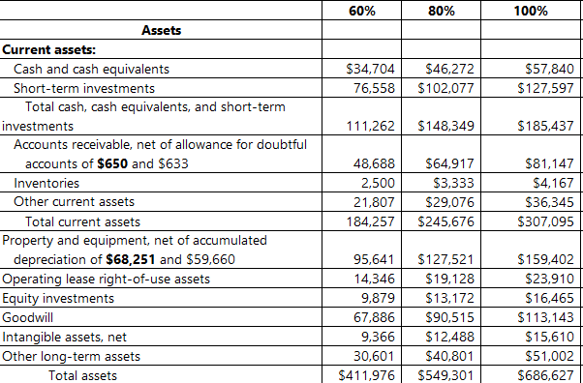
Assets:
1. Current Assets Drive Majority of Asset Base
At 100% capacity, Current Assets = $307,095, making up 44.7% of total assets.
Indicates high liquidity and agility to meet short-term obligations and growth opportunities.
2. Cash & Investments Form a Strong Liquidity Backbone
Combined cash, cash equivalents, and short-term investments rise from $111,262 → $185,437.
Over 66.6% growth, directly aligned with capacity increase.
Solid buffer for operational stability, acquisitions, or R&D.

Slide 4
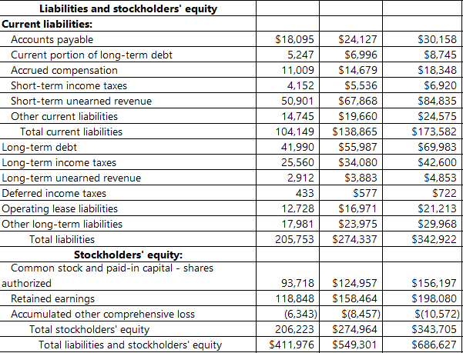
Liabilities:
At 100% capacity:
Total Equity = $343,705 (50.1%)
Total Liabilities = $342,922 (49.9%)
Shows a balanced approach to funding growth through both internal (retained earnings) and external (debt and obligations) sources.

